Slide 2
Agenda
1. Understanding the Basis of Source Separation via an Intuitive Example-Driven
Approach
2. Discussion of Experiment Design
3. Graph Blind Source Separation
4. Graph Blind Source Separation results
Summary of major outcomes
Problems and future research

Slide 3
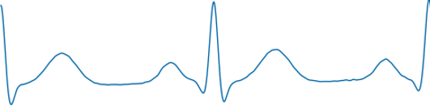
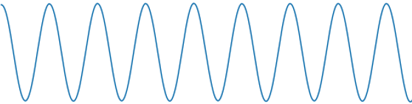
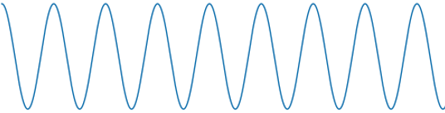
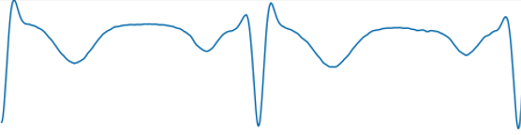
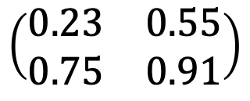
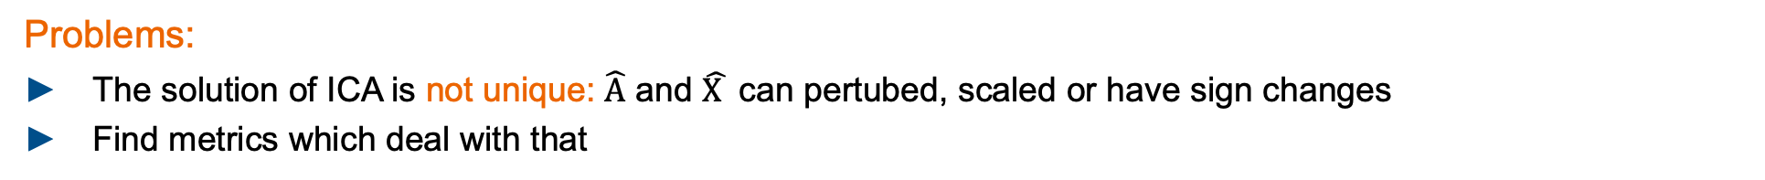
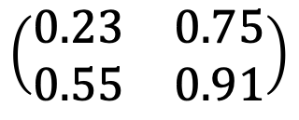

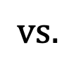


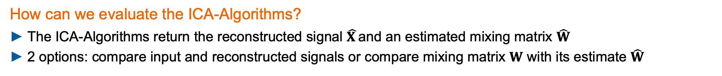

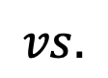
Experiment Design Goal
Goals of this project:
Evaluate ICA - Algorithms in terms of robustness
Elaborating new approaches to increase robustness against noise and outliers in EEG - measurements
How can we evaluate the ICA-Algorithms?
The ICA-Algorithms return the reconstructed signal $\hat{X }$and an estimated mixing matrix $\hat{W}$
2 options: compare input and reconstructed signals or compare mixing matrix $W$ with its estimate $\hat{W}$
$$vs.$$
$$\left(\begin{matrix}0.23 & 0.75 \\ 0.55 & 0.91\end{matrix}\right)$$
$$vs.$$
$$\left(\begin{matrix}0.23 & 0.55 \\ 0.75 & 0.91\end{matrix}\right)$$
$$X$$
$$\hat{X }$$
$$W$$
$\hat{W}$
Problems:
The solution of ICA is not unique: $\hat{A}$ and $\hat{X }$ can pertubed, scaled or have sign changes
Find metrics which deal with that

Slide 4
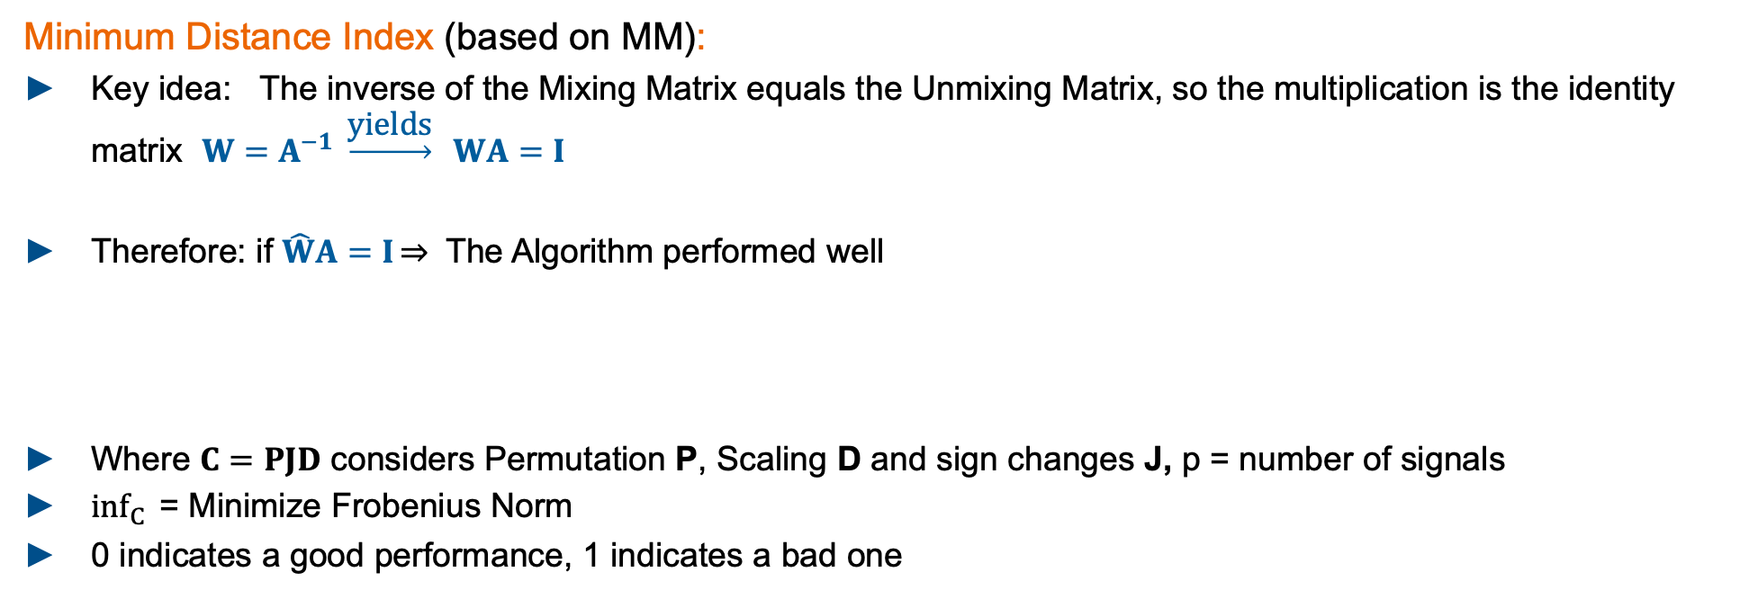
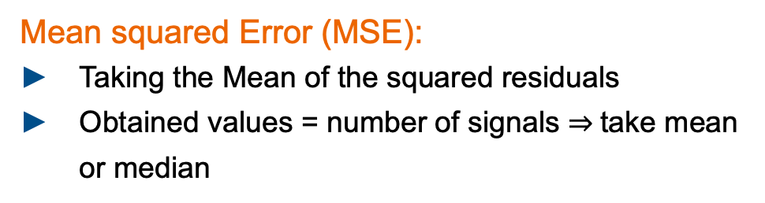
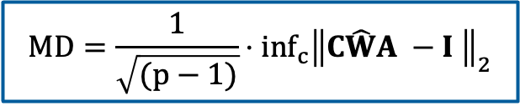
Experiment Design Metrics: MD, MSE
Minimum Distance Index (based on MM):
Key idea: The inverse of the Mixing Matrix equals the Unmixing Matrix, so the multiplication is the identity matrix $W=A^{−1} \underset{→}{\text{yields}} WA=I$
Therefore: if $\hat{W}A=I\overset{⇒}{}$ The Algorithm performed well
Where $C=PJD$ considers Permutation P, Scaling D and sign changes J, p = number of signals
$inf_{C}{ }$= Minimize Frobenius Norm
0 indicates a good performance, 1 indicates a bad one
$$MD=\frac{1}{\sqrt{(p−1)}}⋅inf_{c}{{\left\|C\hat{W}A −I \right\|}_{2}}$$
Mean squared Error (MSE):
Taking the Mean of the squared residuals
Obtained values = number of signals take mean or median
Problem:
Required groundtruth data for X and W
residuals

Slide 5
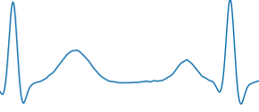
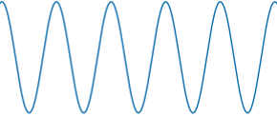
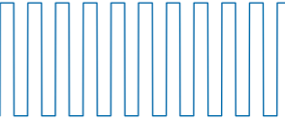
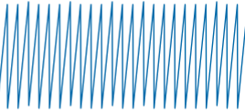
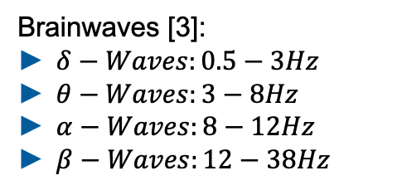

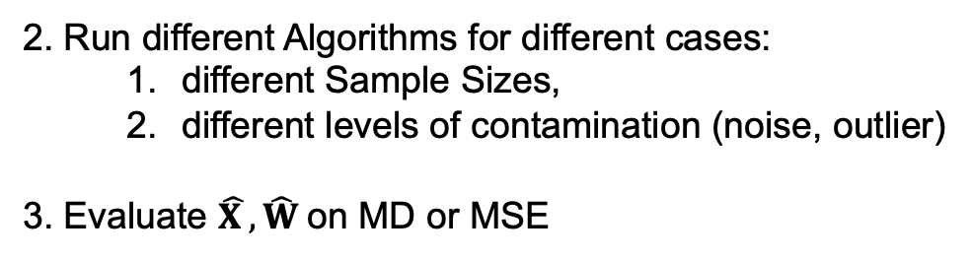
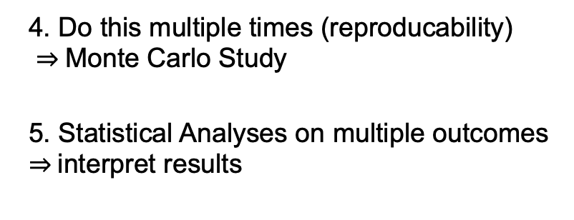
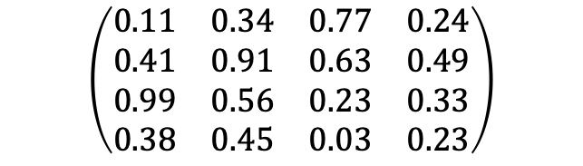
Experiment Design General approach
What we did:
We generated ideal Input Signals $X∈ ℝ^{4x10000}$ and a random ideal Mixing Matrix. $W ∈ ℝ^{4x4}$ groundtruth
Standard Signals:
ECG Signal: 2Hz
Sinus: 5Hz
Rectangle: 10Hz
Sawtooth: 25Hz
fs: 1000Hz
Normalized to [-1,1]
$$\left(\begin{matrix}0.11 & 0.34 & 0.77 & 0.24 \\ 0.41 & 0.91 & 0.63 & 0.49 \\ 0.99 & 0.56 & 0.23 & 0.33 \\ 0.38 & 0.45 & 0.03 & 0.23\end{matrix}\right)$$
Brainwaves [3]:
$δ−Waves:0.5−3Hz$
$θ−Waves:3−8Hz$
$α−Waves:8−12Hz$
$β−Waves:12−38Hz$
2. Run different Algorithms for different cases:
different Sample Sizes,
different levels of contamination (noise, outlier)
3. Evaluate $\hat{X },\hat{W}$on MD or MSE
4. Do this multiple times (reproducability)
Monte Carlo Study
5. Statistical Analyses on multiple outcomes
interpret results

Slide 6

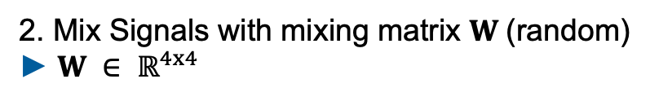

Experiment Design Monte Carlo Flow Chart
Input Signals
Standard input signals
ECG, Sinus, Rectangle, Sawtooth
Runs = 1000
2. Mix Signals with mixing matrix $W$(random)
$W ∈ ℝ^{4x4}$
Mix Signals
Contaminate Signals
3. Contaminate signals
Add single or patchy Outlier (100std) and/or white noise (40dBB)
Whitening
4. Whitening process
Decorrelate Signals: meaning that the sample covariance matrix is diagonal and that all the diagonal elements are equal.
ICA
5. Perform ICA
4 Algos: JADE, RADICAL, CoroICA, PowerICA
$$\hat{X}$$
$$\hat{W}$$
Evaluate on Metrics
6. Evaluate single run
Minimum Distance, MSE
7. Evaluate ICA
Get 1000 MDs and MSEs.
Empirical Data Analyses
BoxPlot

Slide 7

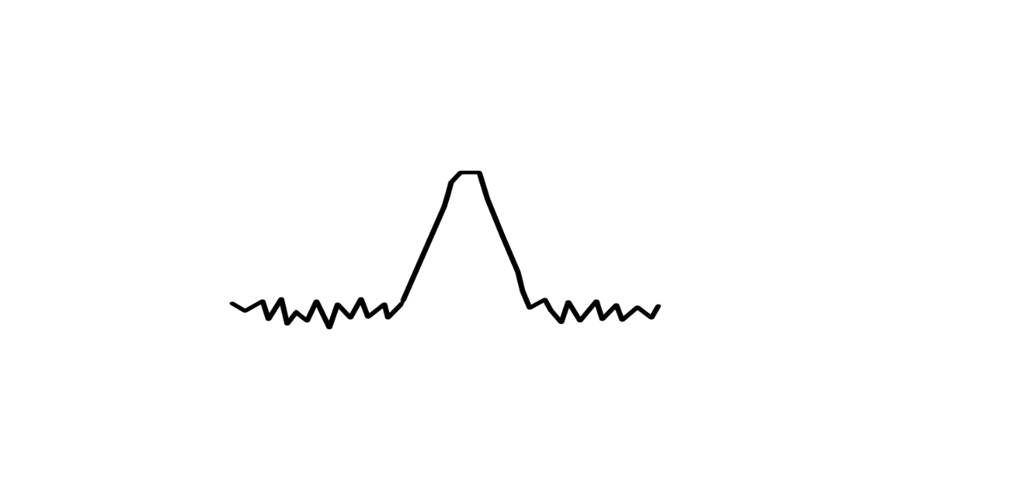

Experiment Design Definition of test characteristics
1.) Focus on Sample Size
Initialize standard signals with different Sample Sizes: 1000, 2500, 5000, 10000, 15000 evaluate on 1000runs
N
Type I: No Noise, No Outlier
Type II: 40dB SNR, No Outlier
Type III: No Noise, 0.1%
Outlier(std = 100)
Type IV: 40dB SNR, 0.1%
Outlier (std = 100)
2.) Focus on amount of noise/outlier – Breakdown Point Analyses
Initialize standard signals with fix Sample Size of 10000
Type V: increase noise, SNR: 40 dB,
30 dB, 20 dB, 10 dB, 6 dB, 3 dB
Type VI: increase Outlier patchy %: 0.1,
0.25, 0.5, 1, 1.5, 5, 10, 20, 50 (100 Std)
Type VII: increase Outlier impulsive %: 0.1,
0.25, 0.5, 1, 1.5, 5, 10, 20, 50 (100 STD)
Notes:
ICONS !!!

Slide 8
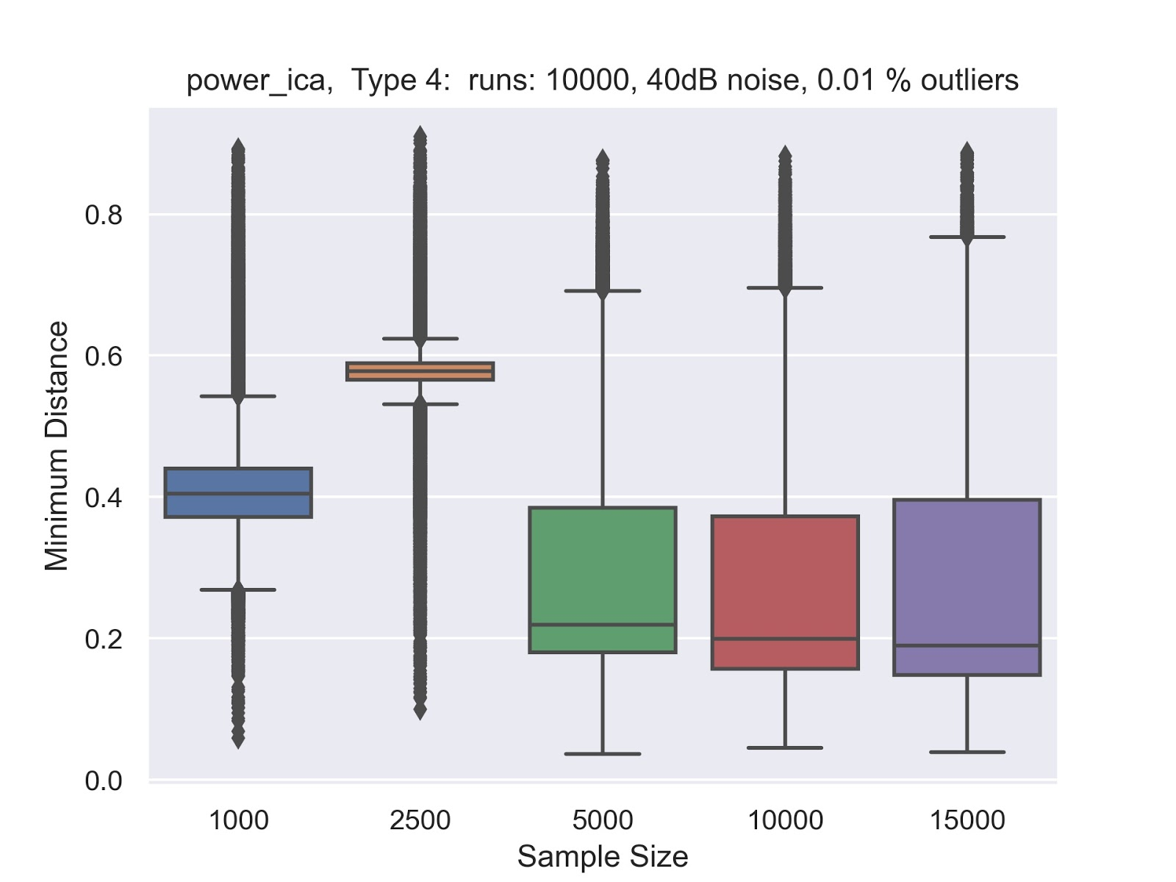
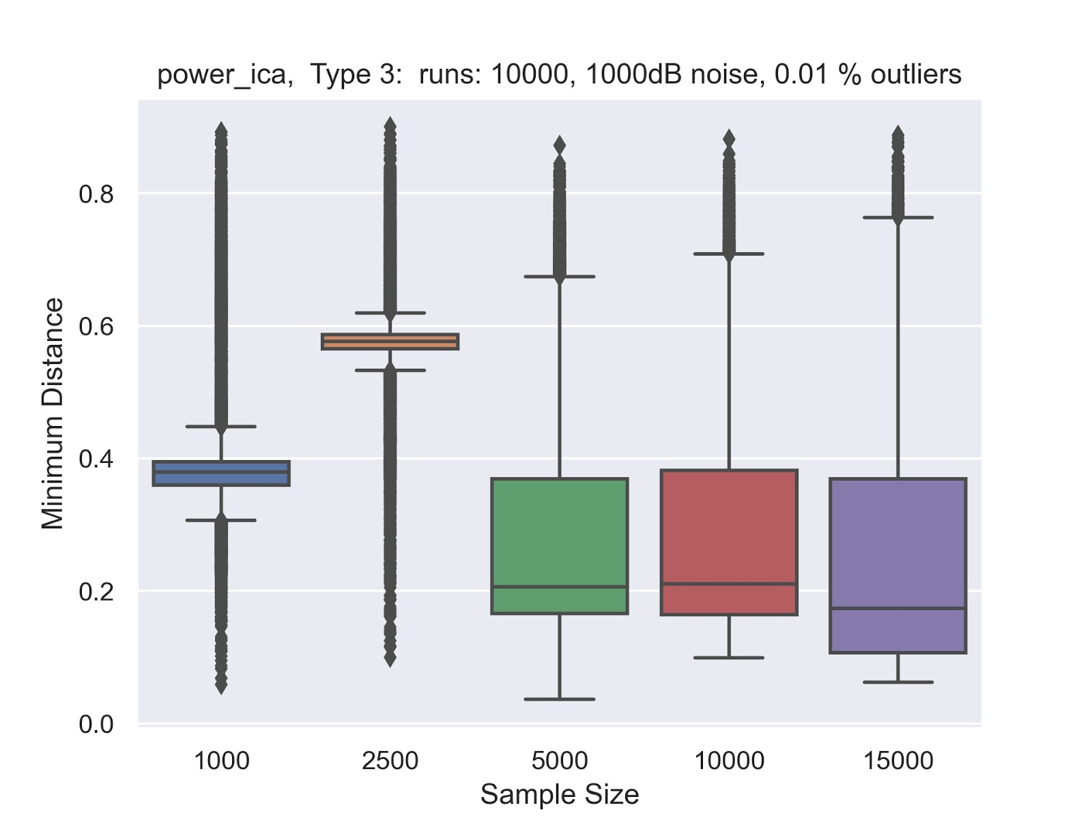
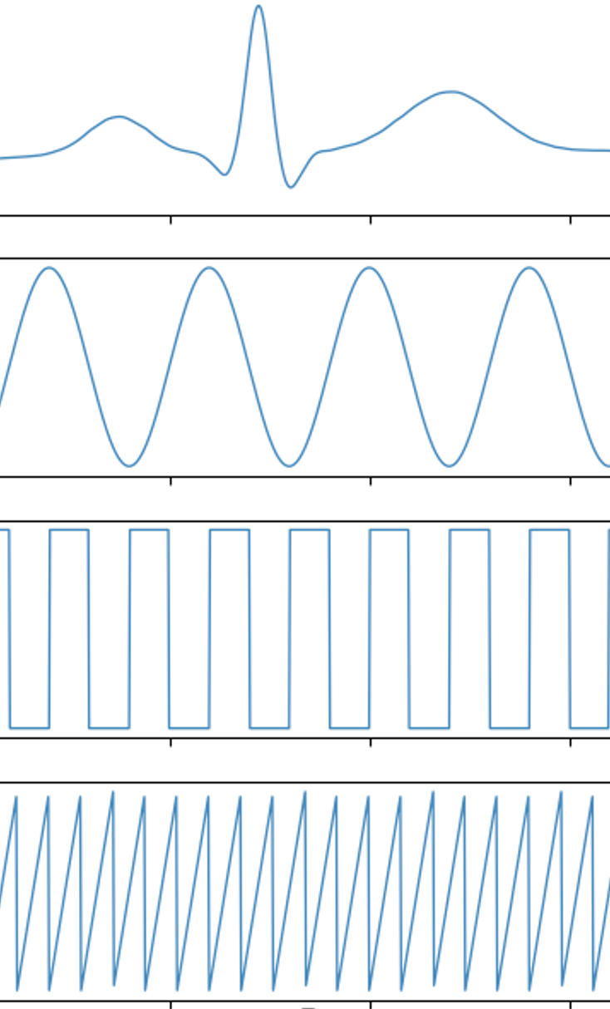
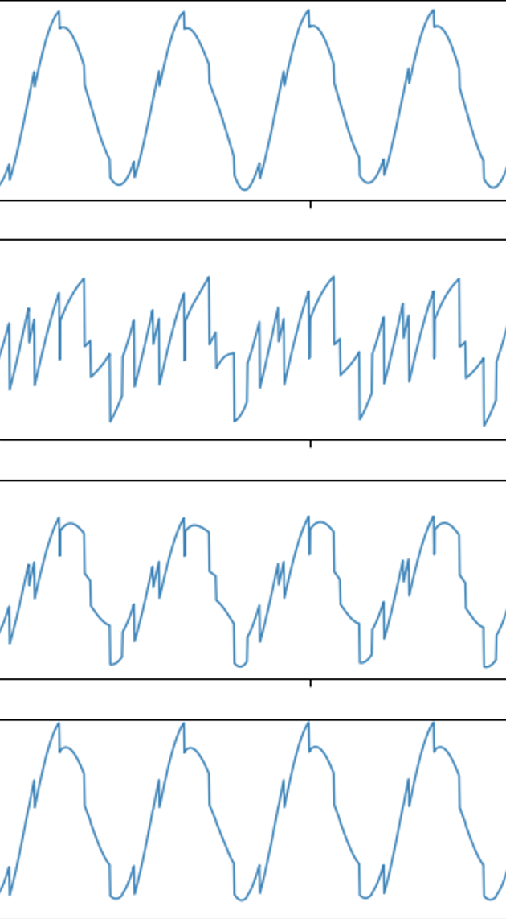
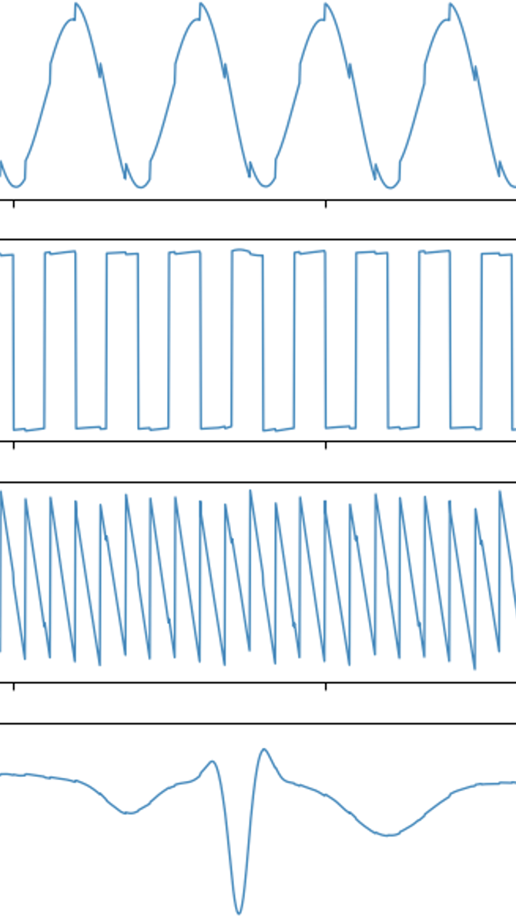

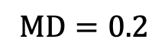
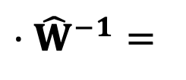
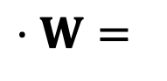
Results Interpreting the Minimum Distance
MD = 0.4
$$⋅W=$$
$$⋅{\hat{W}}^{−1}=$$
MD = 0.6
$$MD=0.2$$
$MD=0.2$ : Good results, small spikes, some sign changes
Notes:
MD not linear ..

Slide 9
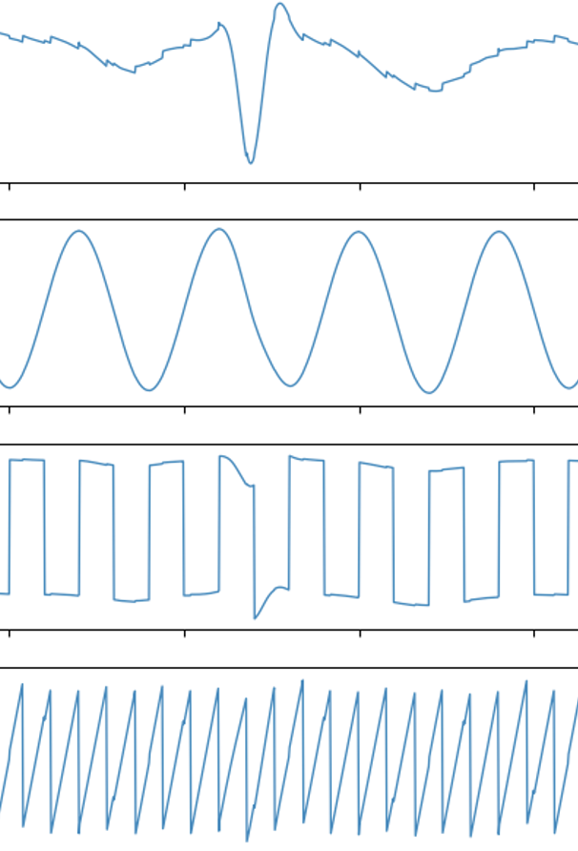
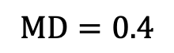

Results Interpreting the Minimum Distance
MD = 0.4
$$⋅W=$$
$$⋅{\hat{W}}^{−1}=$$
MD = 0.6
$$MD=0.4$$
$MD=0.2$ : Good results, small spikes, some sign changes
$MD=0.4$: signals are recognizable, bigger spikes

Slide 10
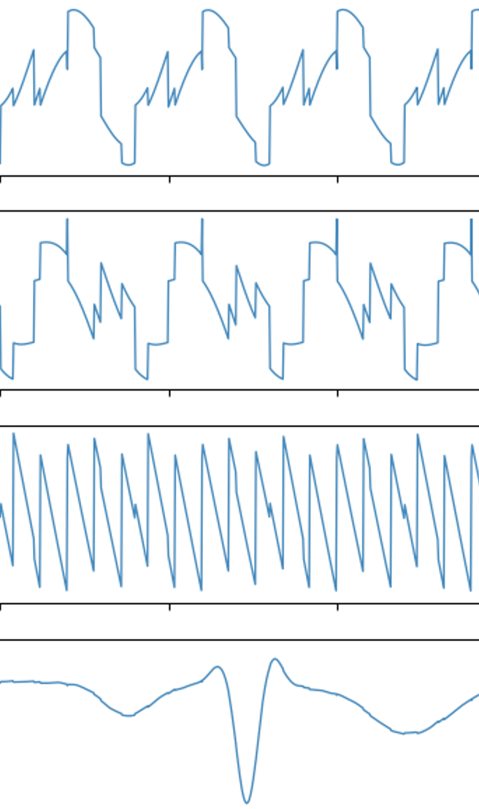
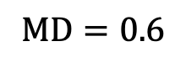
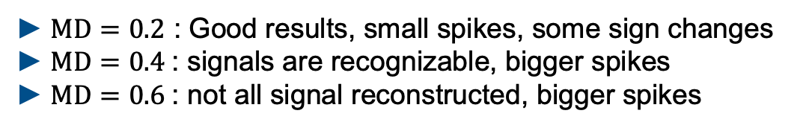
Results Interpreting the Minimum Distance
$$⋅W=$$
$$⋅{\hat{W}}^{−1}=$$
$$MD=0.6$$
$MD=0.2$ : Good results, small spikes, some sign changes
$MD=0.4$: signals are recognizable, bigger spikes
$MD=0.6$: not all signal reconstructed, bigger spikes
Notes:
MD no linear measure – see 0.4 to 0.6

Slide 11
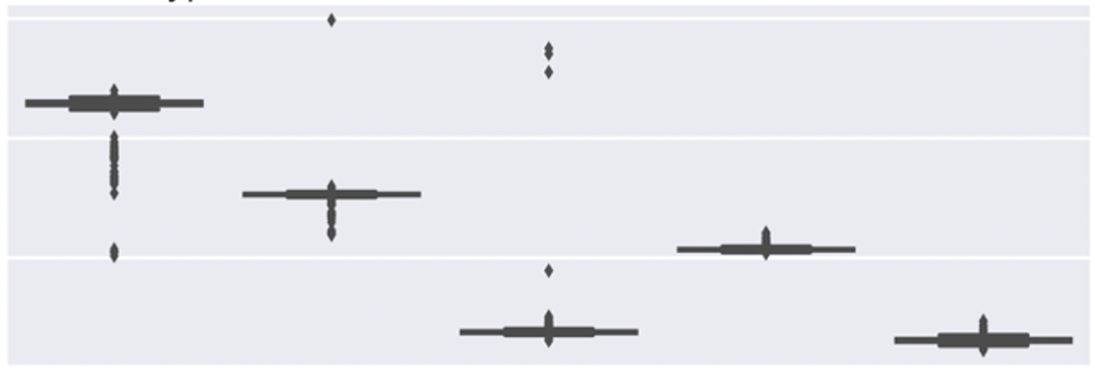
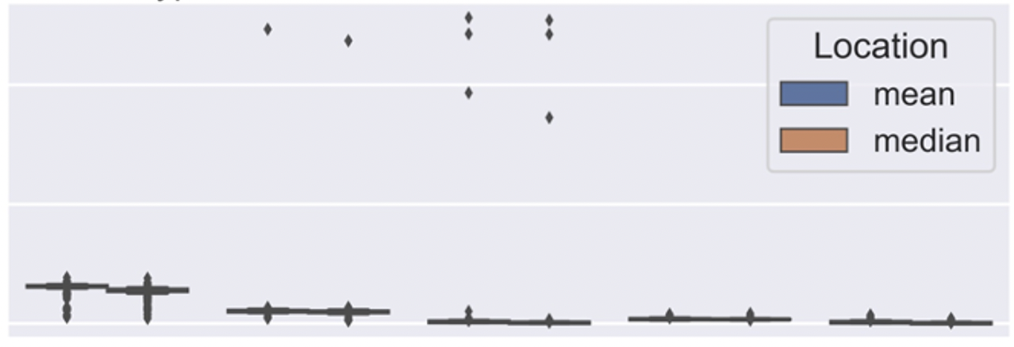
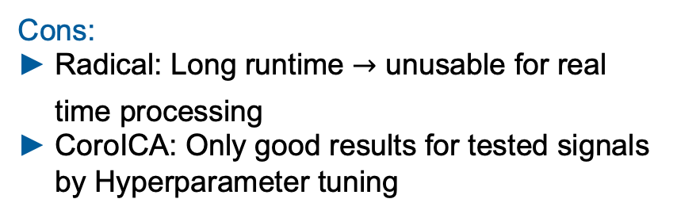
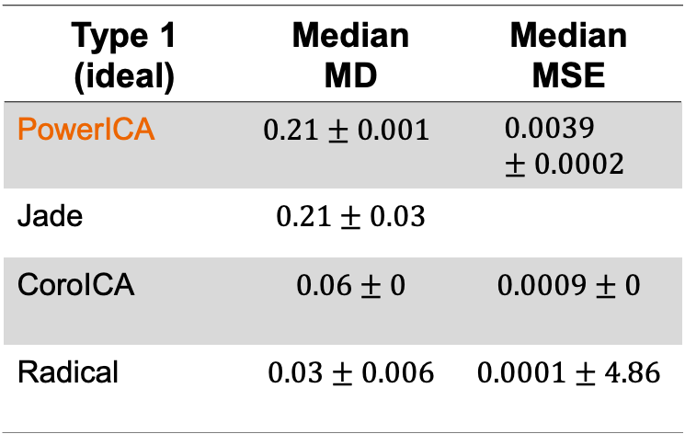
Experiment results Type 1
PowerICA – Type 1: No Noise, No Outlier
Sample Size 10000
0.6
Type 1 (ideal) | Median MD | Median MSE
PowerICA | $$0.21±0.001$$ | $$0.0039±0.0002$$
Jade | $$0.21±0.03$$
CoroICA | $$0.06±0$$ | $$0.0009±0$$
Radical | $$0.03±0.006$$ | $$0.0001±4.86$$
MD
0.4
0.2
0.2
MSE
0.1
0.0
1000
2500
5000
10000
15000
Sample Size
Pros:
All Algorithms are able to reconstruct the source signals
Cons:
Radical: Long runtime unusable for real time processing
CoroICA: Only good results for tested signals by Hyperparameter tuning

Slide 12
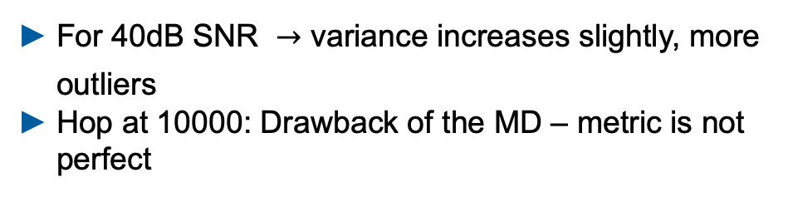
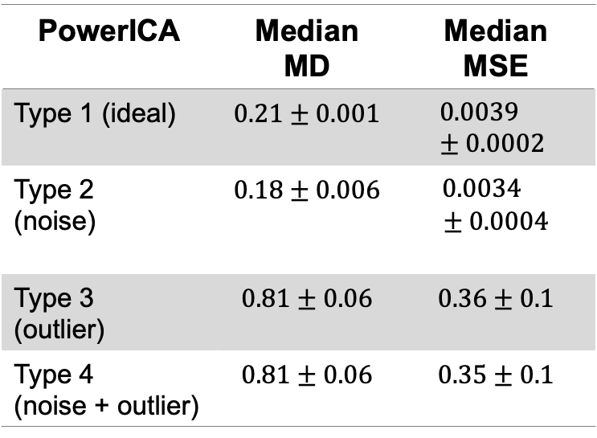
Experiment results Type 1 - 4
PowerICA – Type 1: No Noise, No Outlier
Sample Size 10000
0.6
PowerICA | Median MD | Median MSE
Type 1 (ideal) | $$0.21±0.001$$ | $$0.0039±0.0002$$
Type 2 (noise) | $$0.18±0.006$$ | $0.0034$ $$± 0.0004$$
Type 3 (outlier) | $$0.81±0.06$$ | $$0.36±0.1$$
Type 4 (noise + outlier) | $$0.81±0.06$$ | $$0.35±0.1$$
MD
0.4
0.2
0.2
MSE
0.1
0.0
1000
2500
5000
10000
15000
Sample Size
Sample Size of min. n = 5000 is necessary
Even 0.1% Outlier causes failure for every algorithm
For 40dB SNR variance increases slightly, more outliers
Hop at 10000: Drawback of the MD – metric is not perfect
Next Step:
Breakdown Analyses – How much noise does it take to cause a breakdown?

Slide 13
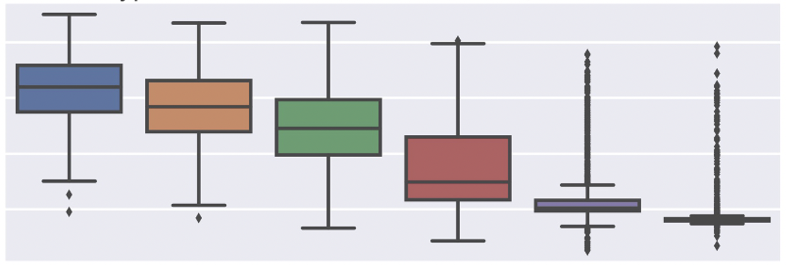
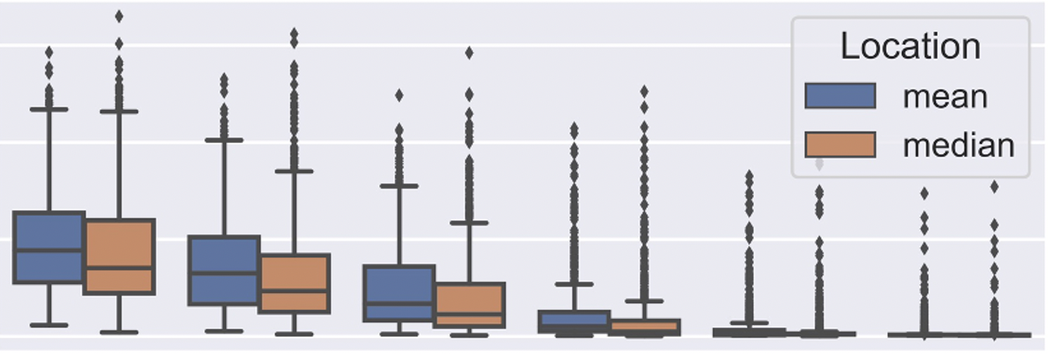


Experiment results Type 5 - 7
Power ICA – Type 5: 3-40dB Noise, No Outlier
Type 6-7:
Complete breakdown even for 1 outlier
0.8
MD
0.6
Type 5:
Noise <20dB SNR breakdown
0.4
0.2
0.6
Did our robustness plugins improve the results ?
MSE
0.4
0.2
Robust Covariance Estimation in Whitening:
Causes breakdown
Robust objective Function in higher Order statistics:
JADE: Causes breakdown
0.0
3.0
6.0
10.0
20.0
30.0
40.0
SNR (additive noise)
Intermediate conclusion:
Preprocessing of the data essential! Outlier removal + smoothing
We need new approaches to improve the performance
Notes:
Felix Kasten

Slide 14
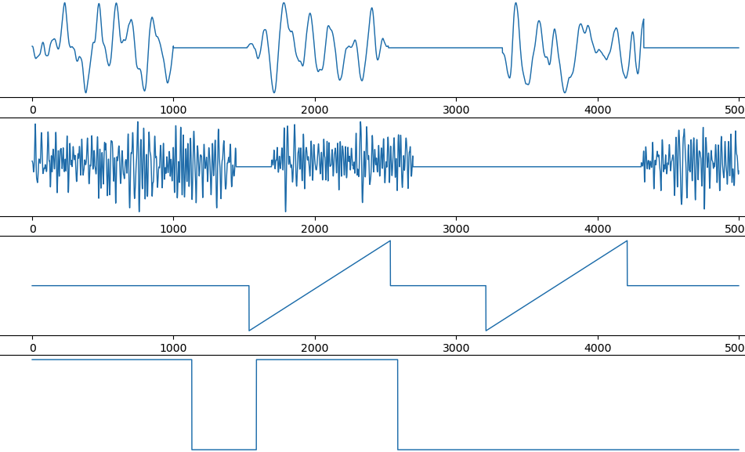
Towards EEG data Synthetic EEG artifact reconstruction
Synthetic - EEG data
1. Use standard signals as input signals
2. Mix Data with random mixing matrix
3. We generated realistic artifacts and added one on each channel
Artifacts which typically come along with EEG data [Delorme2007]
Optional: Add single or patchy (100std) Outliers and white noise (3std)
Realistic artifacts [Delorme2007]
Eye Blink
Muscle
Electrical
Electrical
4. Performed ICA
Notes:
Low frequency events – modelling eye Blink artifacts around 1-3Hz
Transient high frequency events 20-60Hzmodelling muscle artifacts
Signal discontinuities from electrical artifacts
Linear trends from eletrical artifacts

Slide 15
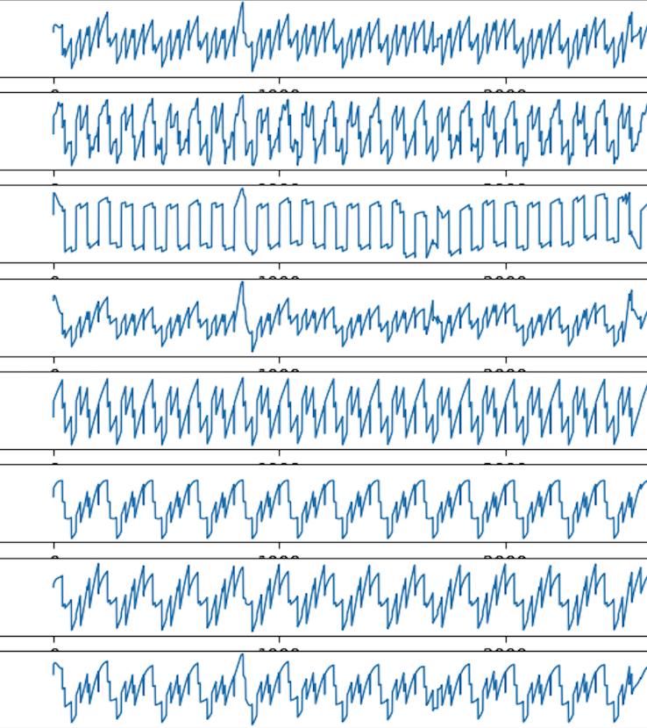
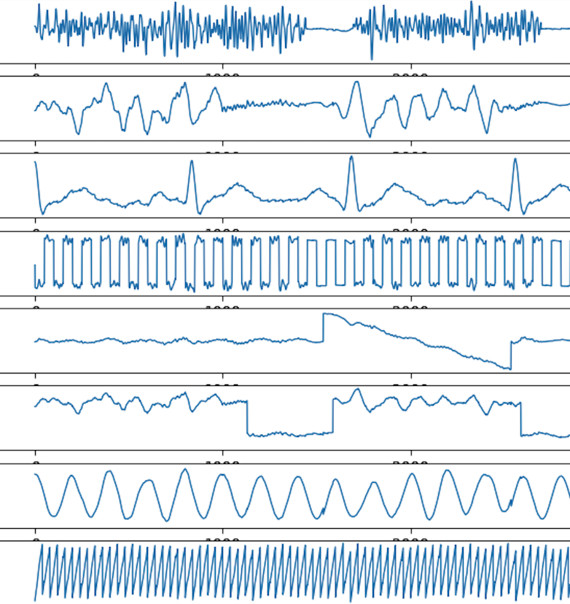
Towards EEG data Results with synthetic EEG data
Mixed signals + added artifacts
Reconstructed signals + artifacts
Muscle
Eye Blink
PowerICA
electrical
electrical
Able to reconstruct the standard signals and the EEG artifacts

Slide 16
Literature
[Delorme2007] - Enhanced detection of artifacts in EEG data using higher-order statistics and independent component analysis in NIH 2007
[2] - https://mne.tools/dev/overview/datasets_index.html visited 02.16.2021
[3] - https://brainworksneurotherapy.com/what-are-brainwaves

Slide 17
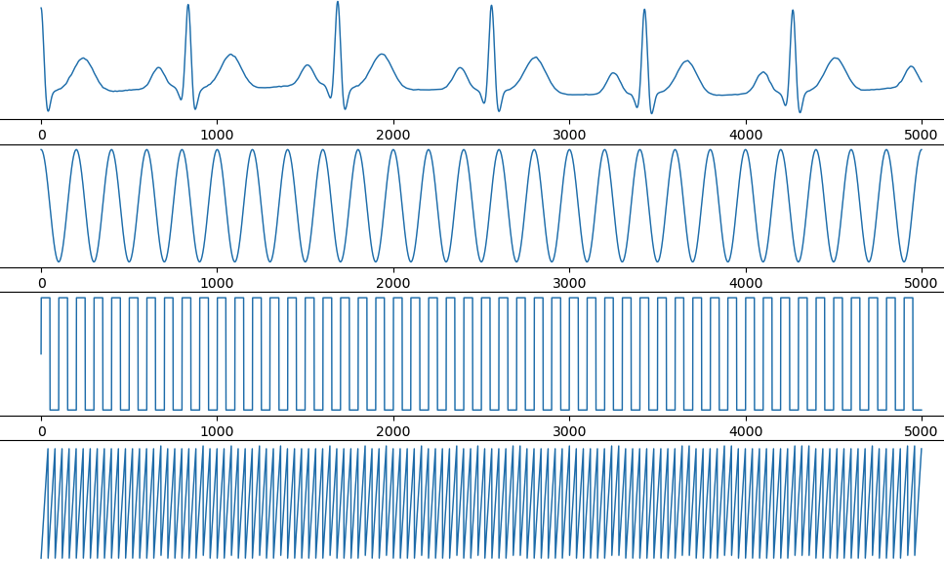
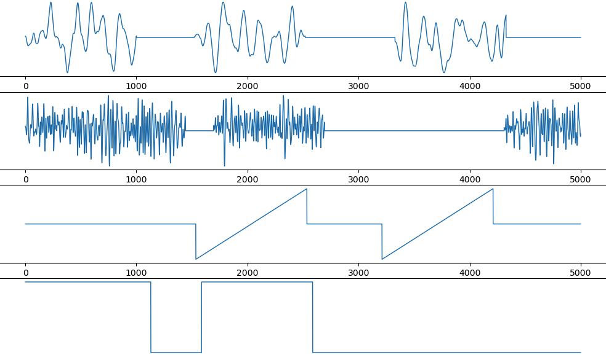
Towards EEG data Results with synthetic EEG data
Mixed signals + added artifacts
Reconstructed signals + artifacts
Standard Input Signals
Synthetic EEG artifacts
PowerICA
Able to reconstruct the standard signals and the EEG artifacts

Slide 18
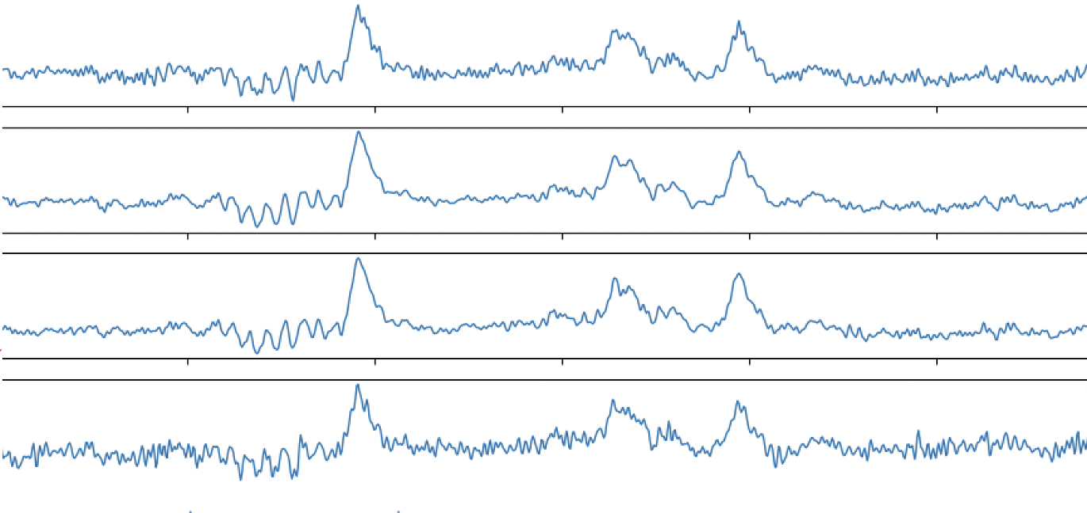

Towards EEG data Synthetic EEG artifact reconstruction
Synthetic - EEG data
EEG - data
1. Use real EEG data as input signals
2. Mix Data with random mixing matrix
Realistic artifacts [Delorme2007]
3. We generated realistic artifacts and added one on each channel
Artifacts which typically come along with EEG data [Delorme2007]
Optional: Add single or patchy (1000std) Outliers and white noise (3std)
Eye Blink
Muscle
Electrical
Electrical
4. Perform ICA
Notes:
Show reconstructed artifacts

Slide 19
Experiment Design Experiment Types
1.) Focus on Sample Size
Initialize standard signals with different Sample Sizes: 1000, 2500, 5000, 10000, 15000
Type I: No Noise, No Outlier, 1000 runs
Type II: 40dB SNR, No Outlier, 1000 runs
Type III: No Noise, 0.1% Outlier with std = 100, 1000 runs
Type IV: 40dB SNR, 0.1% Outlier with std = 100, 1000 runs
N
2.) Focus on amount of noise/outlier – Breakdown Point Analyses
Initialize standard signals with fix Sample Size of 10000
Type V: increase noise SNR: 40 dB, 30 dB, 20 dB, 10 dB, 6 dB, 3 dB
Type VI: increase Outlier patchy %: 0.1, 0.25, 0.5, 1, 1.5, 5, 10, 20, 50 with 100 STD
Type VII: increase Outlier impulsive %: 0.1, 0.25, 0.5, 1, 1.5, 5, 10, 20, 50 with 100 STD
N
Notes:
ICONS !!!

Slide 20

Results Type 5 - 7
Type 6-7:
Complete breakdown even for 1 outlier
Type 5:
Noise <20dB SNR breakdown
Did our Robustness Plugins improve the results ?
Robust Covariance Estimation in Whitening:
Causes breakdown
Robust objective Function in higher Order statistics:
JADE: Causes breakdown
Conclusion:
Preprocessing of the data essential! -> Outlier removal + Smoothing (e.g Low pass Filtering)
We need new approaches to improve the performance

Slide 21


Minimum Distance
MD of 0 -> good, MD->1 bad, Optimum = Identity, Only possible if Ground truth
availavble

Slide 22


Results Type 1 - 4
Power ICA
PowerICA | Median MD | Median MSE | Median SNR [dB]
Type 1 (ideal) | $$0.21±0.001$$ | $$0.0039±0.0002$$ | $$24.16±0.21$$
Type 2 (noise) | $$0.18±0.006$$ | $0.0034$ $$± 0.0004$$ | $$25.93±0.63$$
Type 3 (outlier) | $$0.81±0.06$$ | $$0.36±0.1$$ | $$5.3±1.8$$
Type 4 (noise + outlier) | $$0.81±0.06$$ | $$0.35±0.1$$ | $$5.47±1.78$$
Next Step:
How much noise does it take to cause a breakdown ?
Sample Size of min. n = 5000 is neccessary
Even 0.1% Outlier causes failure for every algorithm
For 40dB SNR -> variance increses slightly, more outliers

Slide 23



MSE, SNR
Evaluate for every single signal

Slide 24

Delorme one slide -> near eeg, closer to reality
2. cases -> classical rosbustness
-> eeg like artifacts
Good and bad recon
Possible Reasons:
Distributions don‘t follow the expected model
Important values are weighted down by new objective functions
Signal to Noise Ratio (SNR):
Considered here as the variance of the resiudal
Transformed in dB
4 values take mean or median
Matrix fett schreiben
Eventuelle andere Signale zeigen auf slide 1
4 Signale ersetzen
Drop bei 10000 erklären -> auf drawbacks von MD hinweisen.
Evtl auch nur bis 5000 zeigen

Slide 25





Experiment Design Monte Carlo Flow Chart III
Input Signals
How do we measure the performance of the Algorithms ?
Runs = 1000
Mix Signals
1. Evaluation on Metrics:
$\hat{X}$ = recovered Signals, $Â$= estimated Mixing Matrix
Evaluate the performance each run
Based on Mixing Matrix: Minimum Distance: $MD(A,Â)$
Based on reconstructed Signals: Mean squared error: $MSE(X,$ $\hat{X}$), Signal to Noise Ratio: $SNR(X,$ $\hat{X}$)
Contaminate Signals
Whitening
ICA
vs.
$$\hat{X}$$
$$Â$$
Evaluate on Metrics
2. Empirical Data Analyses
Get 1000 (#runs) metrics
Calcualte: Mean, Standard Deviation, Median, nMAD of MD,MSE,SNR
BoxPlot
Empirical Data Analyses

Slide 26
Experiment Design Monte Carlo Flow Chart II
Input Signals
Runs = 1000
Whitening
Mix Signals
Plug in robustness
Perform Robust Covariance Estimation from Python Package RobustSP
Spatial Median
M-Estimator of Scatter Matrix (Huber)
Contaminate Signals
Whitening
ICA
Independent Component Analyses
Perform ICA by 4 different Algorithms: JADE, RADICAL, CoroICA, PowerICA
Plug in Robustness JADE: Replace Expected Value by robust objective function.
Huber, Tukey
Evaluate on Metrics
Empirical Data Analyses

Slide 27








Results Interpreting the Minimum Distance
MD = 0.2
MD = 0.4
MD = 0.6

Slide 28




